Slide 1
Emotion based chat bot
Team 6

Slide 2
TABLE OF CONTENTS
1
2
3
4
Conversation Flow
Problem Formulation
Emotions Dataset
Modeling
5
Chat Bot Development
6
Quotes integration (Beta)

Slide 3
1
Problem Formulation

Slide 4
Problem Formulation
Life is stressful and we all find ourselves sometimes in dark places, needing someone to talk to and share our feelings.
For this reason, we propose a chatbot that will assess the current user’s emotion and respond accordingly to improve the users’ mood. For example, If the user is feeling depressed the chatbot should suggest positive activities or send positive messages to ease the user’s feelings.
It will also keep the user engaged in the conversation till the user decides to quit.

Slide 5
2
Conversation Flow

Slide 6
Conversation Flow
Conversation Step | Technique
Greetings | Our chatbot conversation algorithm
Friendly questions to know the user | Our chatbot conversation algorithm
Start conversation with the user | Our chatbot conversation algorithm
Keep conversation going by asking about topics said by the user | Using NER to extract entities mentioned by user
Analyze user sentences | Using emotion classifier
Respond according to the user’s emotion | Using responses dataset according to user emotion

Slide 7
3
Emotions Dataset

Slide 8
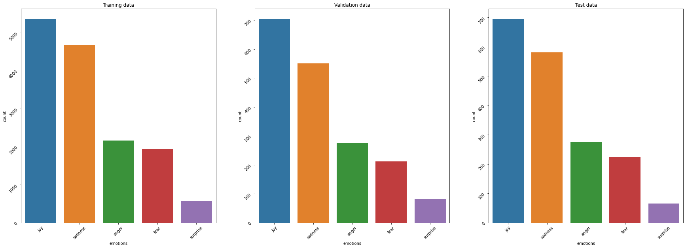
Data Visualization (Distribution)

Slide 9
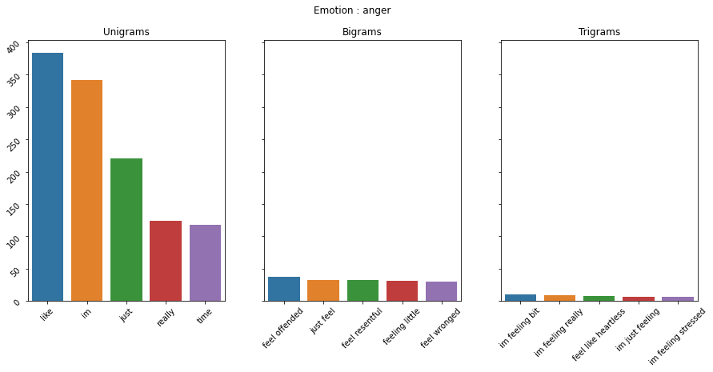
Data Visualization (N-Grams)

Slide 10
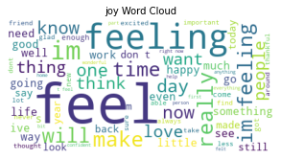
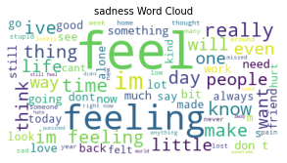
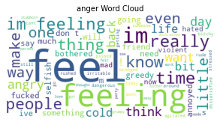
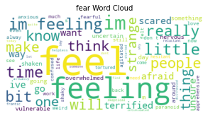
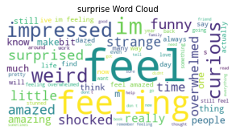
Data Visualization (Word cloud)
joy
sadness
anger
fear
surprise

Slide 11
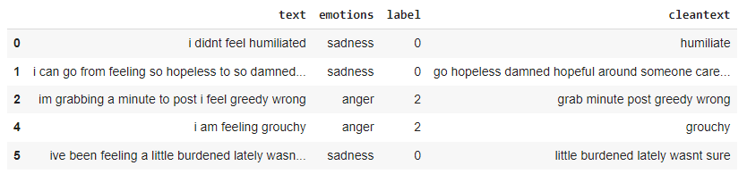
Data Preparation
Lemmatization
Remove punctuation
Remove stop words
Remove unnecessary words (feel, feeling, felt …)

Slide 12
4
Modelling

Slide 13
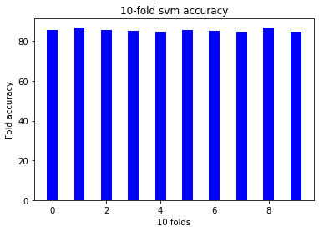
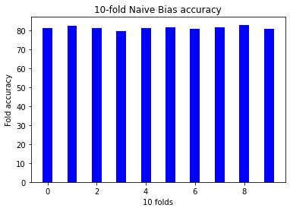
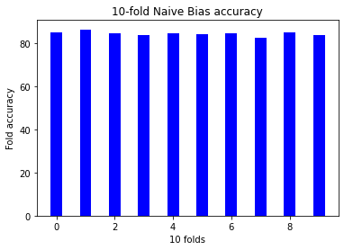
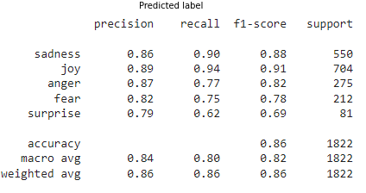
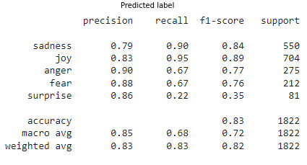
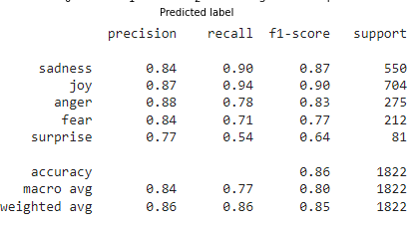
Models
svm
Naive Bayes
Logestic Regression
Validation dataset

Slide 14
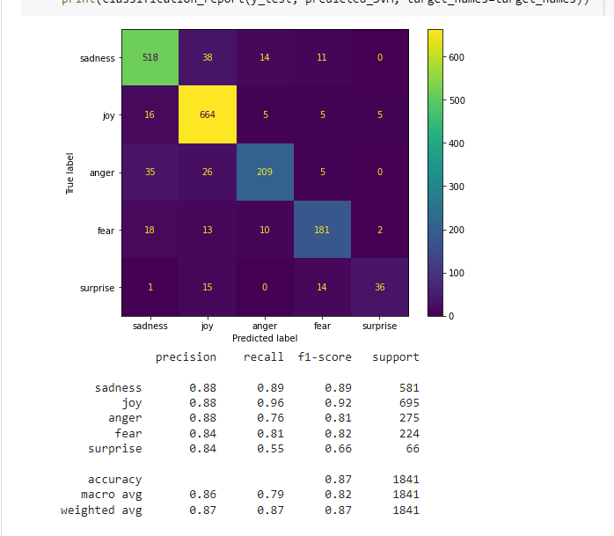
Champion Model Analysis
The champion model is SVM based on comparison of precision and recall
Test dataset

Slide 15
5
Chatbot Development

Slide 16
Chatbot development (Algorithm)
Greet the user (greeting)
Get User info (greeting)
Invoke the user to talk (talking)
Collect entities from user’s input (talking)
If no entities are found, invoke the user to talk again (talking)
Ask user about entities (talking)
Wait till we have at least 2 sentences from user
Evaluate collected users input emotion & Respond to user input
Using our responses dataset

Slide 17
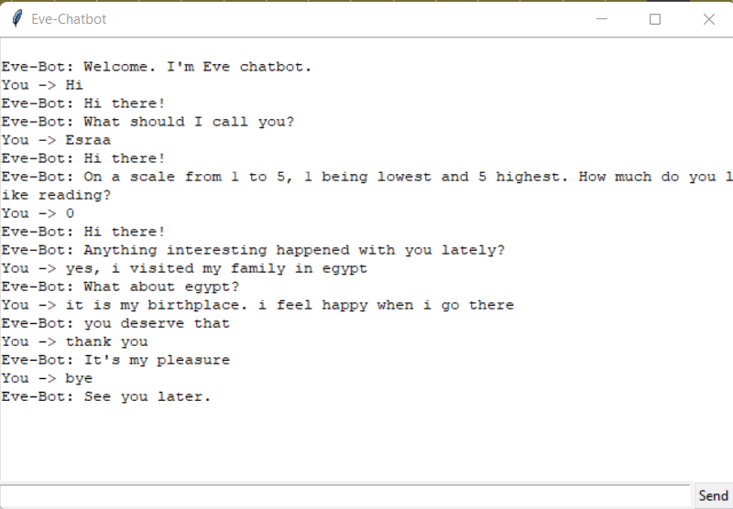
Chatbot development (Demo-joy)

Slide 18
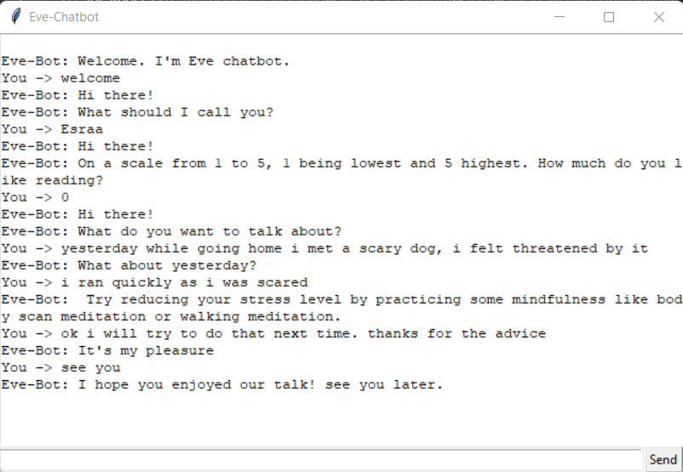
Chatbot development (Demo-fear)

Slide 19
6
Quotes Integration (Beta)

Slide 20
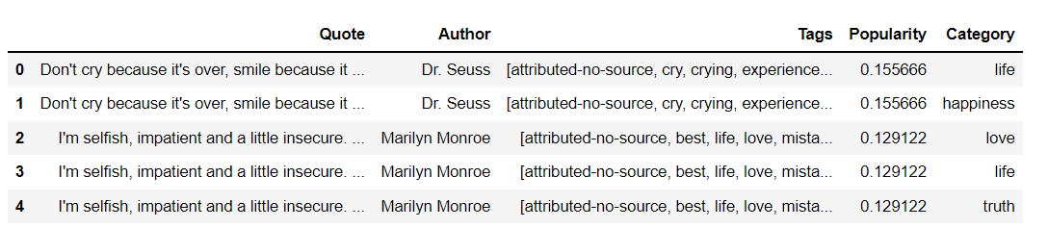
Quotes Integration(Beta)
Dataset
- Emotion classifier was used to get emotion of quotes
- Some quotes of famous authors were selected (to reduce data size)
- K-Means was used to cluster the data

Slide 21
Quotes Integration(Beta)
Updating the chatbot response
Wait till we have at least 2 sentences from user
Pick randomly a response method
Evaluate collected user’s input & try to get a matching quote by getting emotion and cluster number
Evaluate collected users input emotion & get appropriate response
Respond to the user

Slide 22
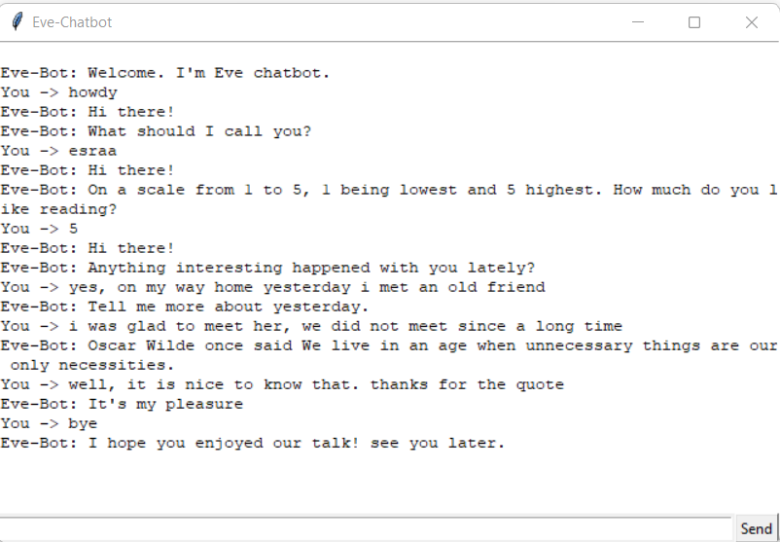
Quotes Integration(Beta)

Slide 23
THANK YOU

